Slide 1
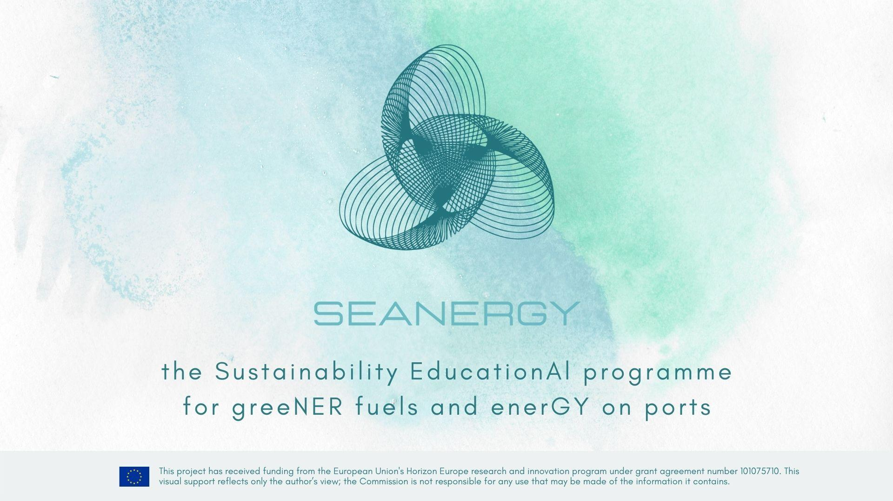




Slide 2
Module 6
“Local Masterplan Development”
Course coordinator(s):
Werner Auer – main coordinator (w.auer@ennshafen.at)
Ronny Lorch (rl@argo-anleg.de)
Name of the organization / country:
Ennshafen OÖ GmbH / Austria
Argo-Anleg GmbH / Germany

Slide 3
Learning objectives of the course
On completion of this course, the participants will be able to:
develop a basic knowledge of establishing an inland port development plan with support of the SEANERGY master plan
improve your existing knowledge and experience on inland port business regarding energy-related items
identify options for fulfilling the future challenges of inland ports regarding energy
learn about best practices and strategy developments of inland ports

Slide 4
Introduction (1)
Inland ports on Europe´s waterways are facing a big challenge today
Part of heavy logistics business, which is accompanied big amounts of energy (for vessels, rail and trucks) for the huge transhipment figures
Even if waterway business is considered to be an environmentally friendly mode of cargo transport, considerable amounts of fuels are needed resulting in big amounts of CO₂-emissions in total (and even other air pollutants) and need special efforts to comply with Green Deal targets for 2030 - 2050

Slide 5
Introduction (2)
Ports need a master plan, a sound strategy & action plan with concrete realistic measures to comply with these challenges for the future
This course module will give support how to go into this tasks
This module is not a “bible”, it could be of help for the management how to start into it, probably a check list, what should be done or considered and a cross-check of what other ports have thought about
In any case - it is necessary to find the taylor-made best approach for each port in his special vicinity

Slide 6
Topics covered in the course (1)
General information regarding energy items of inland port businesses
The port and its national and international context regarding
legal needs for the future energy developments
Market situation and business opportunities in the context of the SEANERGY master plan content
Assessment of identified action fields for energy improvement possibilities

Slide 7
Topics covered in the course (2)
Target groups integration
Deployment of an inland port development plan about energy items, but integrated in the company´s development strategy process
Setup of a PDCA-cycle (Plan-Do-Check-Act) in the strategy context regarding energy development plans (integrated in the company´s business strategy)
Some practical examples how to come to a transformation plan towards sustainability and green energy use

Slide 8
Inland ports - general information regarding the energy items of inland port businesses
Energy sources used for heavy logistics: “Diesel – Diesel – Diesel”, electricity; even gasoline and LNG or LPG in smaller amounts (99 % ?)
Mobile equipment needs diesel; up to now no competitive fuels are available > we all know, that this is a big challenge because of CO₂-emissions of fossil diesel > but what other solutions are really promising ?
Electricity for stationary equipment (railways, gantry cranes) or quickly rechargeables (fork lifts, …) or transport devices (conveyor belts)
Big question: is the used electricity really “green” ? (grid of your country)

Slide 9
The (inland) port and its national and international context regarding legal needs for the future energy developments (1)
TEN-T-Regulation / Regulation (EU) No 1315/2013 of 11.12.2013 on Union guidelines for the development of the trans-European network (new version is expected to come into force in 2024) > please update soon
CEF-2 / Connecting Europe Facility – Regulation (EU) 2021/1153 of the European Parliament and the Council of 7.7.2021 establishing the Connecting Europe Facility – very important for funding and financing
Rhine-Danube Corridor / 4th Work Plan of European Coordinator (2020)
EU Green Deal Initiative COM(2019)640 final (and deployed documents)

Slide 10
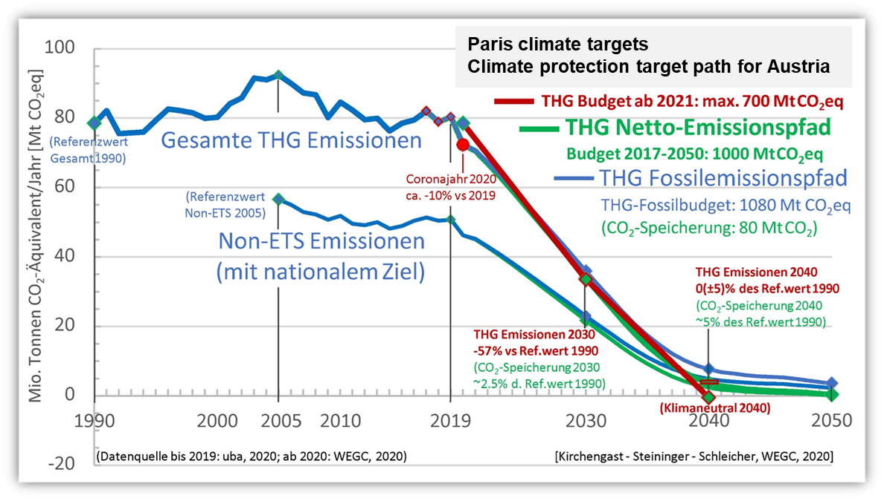
The (inland) port and its national and international context regarding legal needs for the future energy developments (2)

Slide 11
The (inland) port and its national and international context regarding legal needs for the future energy developments (3)
AFID / Directive (EU) 2023/1804 of 13.9.2023 - regarding deployment of alternative fuels infrastructure (repealed old AFID 2014(94/EU)2014)
SSMS / Sustainable and Smart Mobility Strategy (9.12.2020 / European Commission COM(2020) 789 final)
Fit for 55 Program /14.7.2021) / reducing net greenhouse gas emissions by at least 55 % by 2030”
NAIADES III (24.6.2021) / boosting future-proof European inland waterway transport, COM(2021) 324

Slide 12
The (inland) port and its national and international context regarding legal needs for the future energy developments (4)
Zero Pollution Action Plan COM(2021)400final, adopted on 12.5.2021 >>> “zero emission mobility is the major objective”
National requirements (depends on the country of the port / e.g. Austria)
Current governmental program Austria 2020-2024
Austrian Recovery and Resilience Plan 2020-2026, 30.4.2021
Mobility Masterplan 2030 for Austria (15.7.2021)
Master Plan of viadonau for shore power supply in Austria (2019)

Slide 13
The (inland) port and its national and international context regarding legal needs for the future energy developments (5)
Danube Action Program of Austrian Ministry bmk (2023)
Upper Austrian spatial planning strategy “upper REGION2030” (May 2020)
Upper Austrian energy strategy “Energieleitregion OÖ2050” (2020)
Upper Austrian mobility strategy “Mobilitätsleitbild 2035”
….
> A big variety of legal framework documents for the development of ports

Slide 14
Market situation and business opportunities in the context of the SEANERGY master plan content
Everybody calls for green mobility and zero emission transport in the markets – every time meant seriously? or even “green washing”?
Demand and calls vs. technical solutions and accepted prices
Recent development (just upcoming): CSRD (corporate sustainability reporting directive) and EU Taxonomy regulation (for investments !); these sources are looking of real data (CO₂-neutrality,
climate change, …– upcoming claims from the clients
EU-Supply-Chain-Law: in force since 25.7.2024 > stepwise realisation 2026-2027-2028… – will bring new dynamic from market/clients

Slide 15
Assessment of identified action fields for energy improvement possibilities (1)
Basic assessments start at the status quo of the port - energy balance of the port / modes of energy sources, amounts used for different processes
Compare the status quo with the listed new targets and legal papers
Important: what kind of organisation has your port – stand alone and be responsible for all processes vs. landlord port with complex PPP-system
Look in detail into your port´s: infrastructure, suprastructure, equipment, facility boundaries, digitalisation, automatisation, hinterland connections, utilities, port accessability (rail/road/vessel), onshore power, alternative fuels (LNG, …), …

Slide 16
Assessment of identified action fields for energy improvement possibilities (2)
Grids of your local energy supply (electricity) and backbone system of the electricity vendors
Bunkering stations of fuels (or vessels)
Energy production within the port: photo voltaic, biomass combustion / turbines, biogas …
Energy exchange between plants within the port
Energy storage, energy recuperation, …
Energy standards of your buildings (premises, warehouses, …)

Slide 17
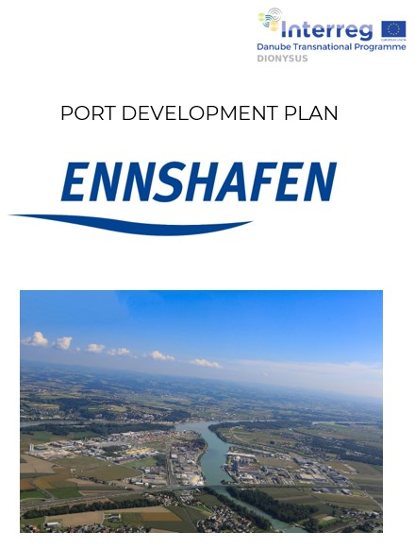
Target groups integration (1)
A lot of port processes and infrastructure had been investigated in the previous chapter – could this be done by the port company itself ?
or does there exist an integrated network of many
partners and players, which are together responsible
for these processes and assets ?
This leads to „target group integration“
Each port has to find out and define his own specific
„fields of players“ regarding energy items within
the port areal
PDP ENNSHAFEN
Established in 2022,
with annual review
Copyright: ENNSHAFEN

Slide 18
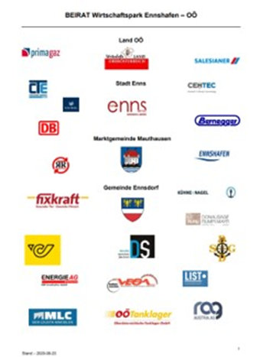
Target groups integration (2)
Be carefully / definitions: stakeholders vs. target groups /stakeholders
Shareholders: owners, normally multi-field of owners many partners); they may have completely different approaches regarding energy leading to divergent / diametral strategies (e.g. provider of biomass (energy) vs. electricity grid company vs. PV-user, …. > diplomacy !
Agreement of advisory board - Wirtschaftspark Ennshafen Upper Austria
Copyright: ENNSHAFEN

Slide 19

Target groups integration (3)
Typical target groups for a (inland) port may be: municipality / district, local public authority, national public authority and several business agencies, neighbors / public / press / media, clients (multiple field of clients), vendors, service providers and operators, existing and potential companies settled in the port, others (fishery, …)
HAFENJournal - Annual magazin of Ennshafen port 2024
Copyright: ENNSHAFEN

Slide 20
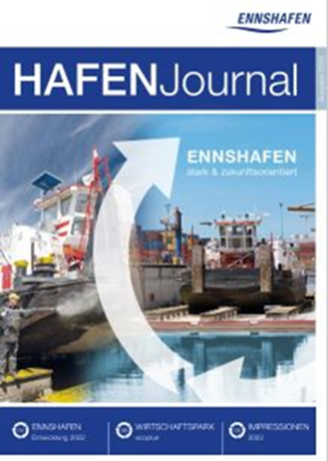
Target groups integration (4)
Find a suitable way – even if this may be very difficult –
to stay in permanent or periodic contact with all of them – keep communication
Find a suitable way to get out the ideas and wishes of all of them regarding energy development of the port or items which may influence these developments and put these informations into a matrix
(„field of competitive interests“)
HAFENJournal - Annual magazin of Ennshafen port 2023
Copyright: ENNSHAFEN

Slide 21
Deployment of port development regarding energy items, but integrated in the total company development strategy process (1)
Starting point: a lot of (divergent) ideas, wishes, initiatives, targets, requirements, orders (laws), ….. – in fields of energy & sustainability
Set priorities under the framework of your company´s vision and business strategy, even look on best practices and frameworks of your agencies
Integrate the energy / sustainability items into the company´s strategy, don’t make a parallel world!

Slide 22
Deployment of port development regarding energy items, but integrated in the total company development strategy process (2)
Energy items must be dealt at the same way as transshipment figures, income figures, income rations, … in your business papers, only with fully integration you will be successful in the end
Find the right way – “the red line” - through the jungle of items in the specific playing field of your port to the starlight of your company´s vision or high-level targets

Slide 23
Deployment of port development regarding energy items, but integrated in the total company development strategy process (3)
Cluster all items and make an evaluation and prioritizing based on a gap-analyses (if you identify incompliances with requirements) and via a SWOT-analyses. Take for each field the
5 most important items and put them to your management board level > create the “strategic focus” with energy items

Slide 24
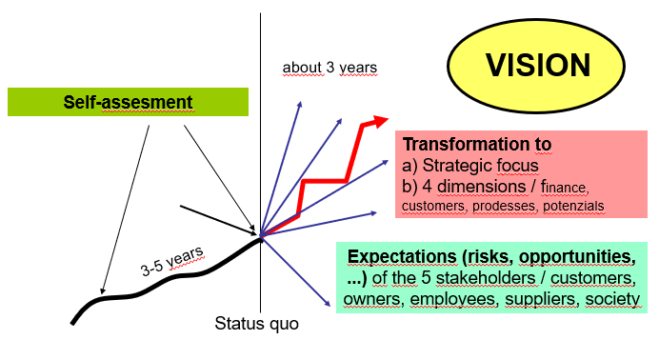
Deployment of port development regarding energy items, but integrated in the total company development strategy process (4)
Don´t make a local master plan only for energy, it cannot survive stand alone,
it has to be integrated in daily/monthly/
yearly ordinary management process and business gouvernance of your port company
How to achieve the VISION?
Copyright: ENNSHAFEN

Slide 25
Deployment of port development regarding energy items, but integrated in the total company development strategy process (5)
Concentrate on your targets, set up the strategic focus and the deploy the action plan which can bring you to the aimed targets
But be careful and develop everything in a balanced way – if your energy and sustainability targets do not comply with the financial framework of your company or the targets you got by the shareholders, then forget the way and start new; a stand-alone master plan only for energy might become quickly only wishful thinking

Slide 26
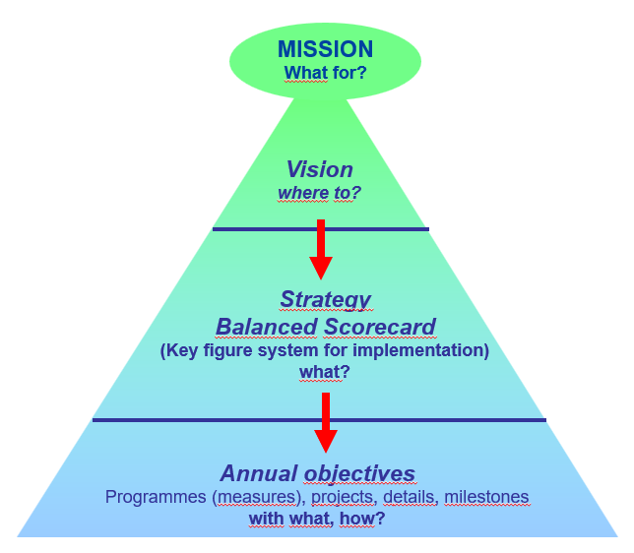
Setup of a PDCA-cycle in the strategy context regarding energy development plans (integrated in company´s business strategy)
Permanent and fully integrated into your ordinary management processes, don’t make a parallel world
Energy items are the same level and at the same priority as other KPIs of your company´s dashboard (“balanced shore-card”)
What is our MISSION?
Copyright: ENNSHAFEN

Slide 27
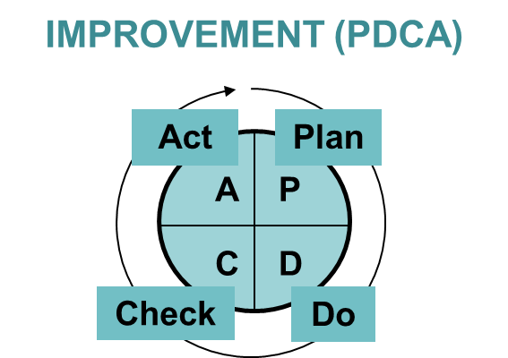
Setup of a PDCA-cycle in the strategy context regarding energy development plans (integrated in company´s business strategy)
PDCA is the magic word:
Plan – Do – Check -Act
Copyright: ENNSHAFEN

Slide 28
Some practical examples regarding energy items for ports to come to a transformation plan towards sustainability / green energy (1)
The outcome of your CO₂-evaluation is most likely that the big amounts of your CO₂-accounting derives from diesel emission
Now you can look for technical alternatives: change energy source from fuel to electricity (if your country has got electricity with low CO₂ accounts, otherwise you will probably only shift CO₂ from one to the other mode; e.g. technical solution will be possible – change a diesel-fueled crane and install an electricity driven gantry crane – but: is this economically viable ?
who will pay for additional cost ?

Slide 29
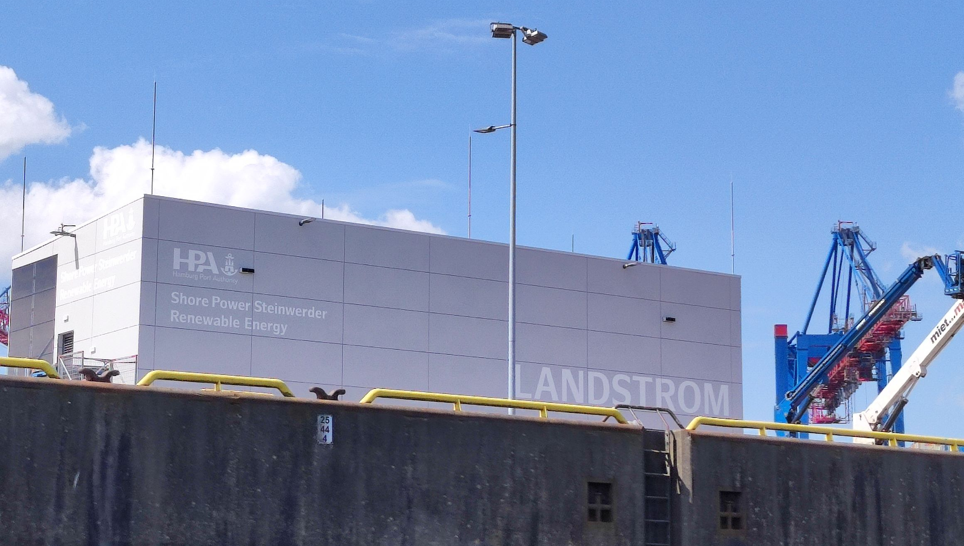
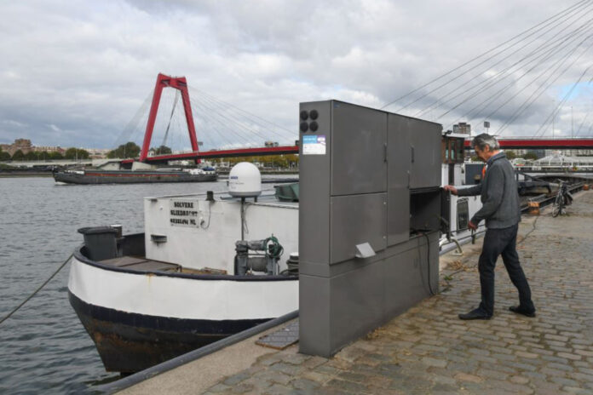
Some practical examples regarding energy items for ports to come to a transformation plan towards sustainability / green energy (2)
ONE EXAMPLE WHICH IS TODAY OF HIGH PRIORITY FOR A PORT:
“how to come to CO₂-neutrality until 2050” – you have to setup a transformation plan for your books and yearly checked the book auditor
Copyright: ENNSHAFEN
Copyright: Port of Rotterdam

Slide 30
Some practical examples regarding energy items for ports to come to a transformation plan towards sustainability / green energy (3)
Start with your status quo of CO₂-emission balance
Use standard model of Scope 1/ Scope 2 / Scope 3 (even if there is still work needed to get the right CO₂-emission factors for all port processes)
[16.12.2022: CSRD – Corporate Sustainability Reporting Directive / outlines the obligation for companies to use standards to fulfil their legal sustainability reporting obligations (>>> until 6.7.2024 into national laws); 2023 (ongoing): ESRS – European Sustainability Reporting Standards (draft / w.i.p.) / will be mandatory for use by companies, defines all details to ensure that companies across the EU report comparable and reliable sustainability information]
DOWNLOAD CSRD STANDARDS

Slide 31
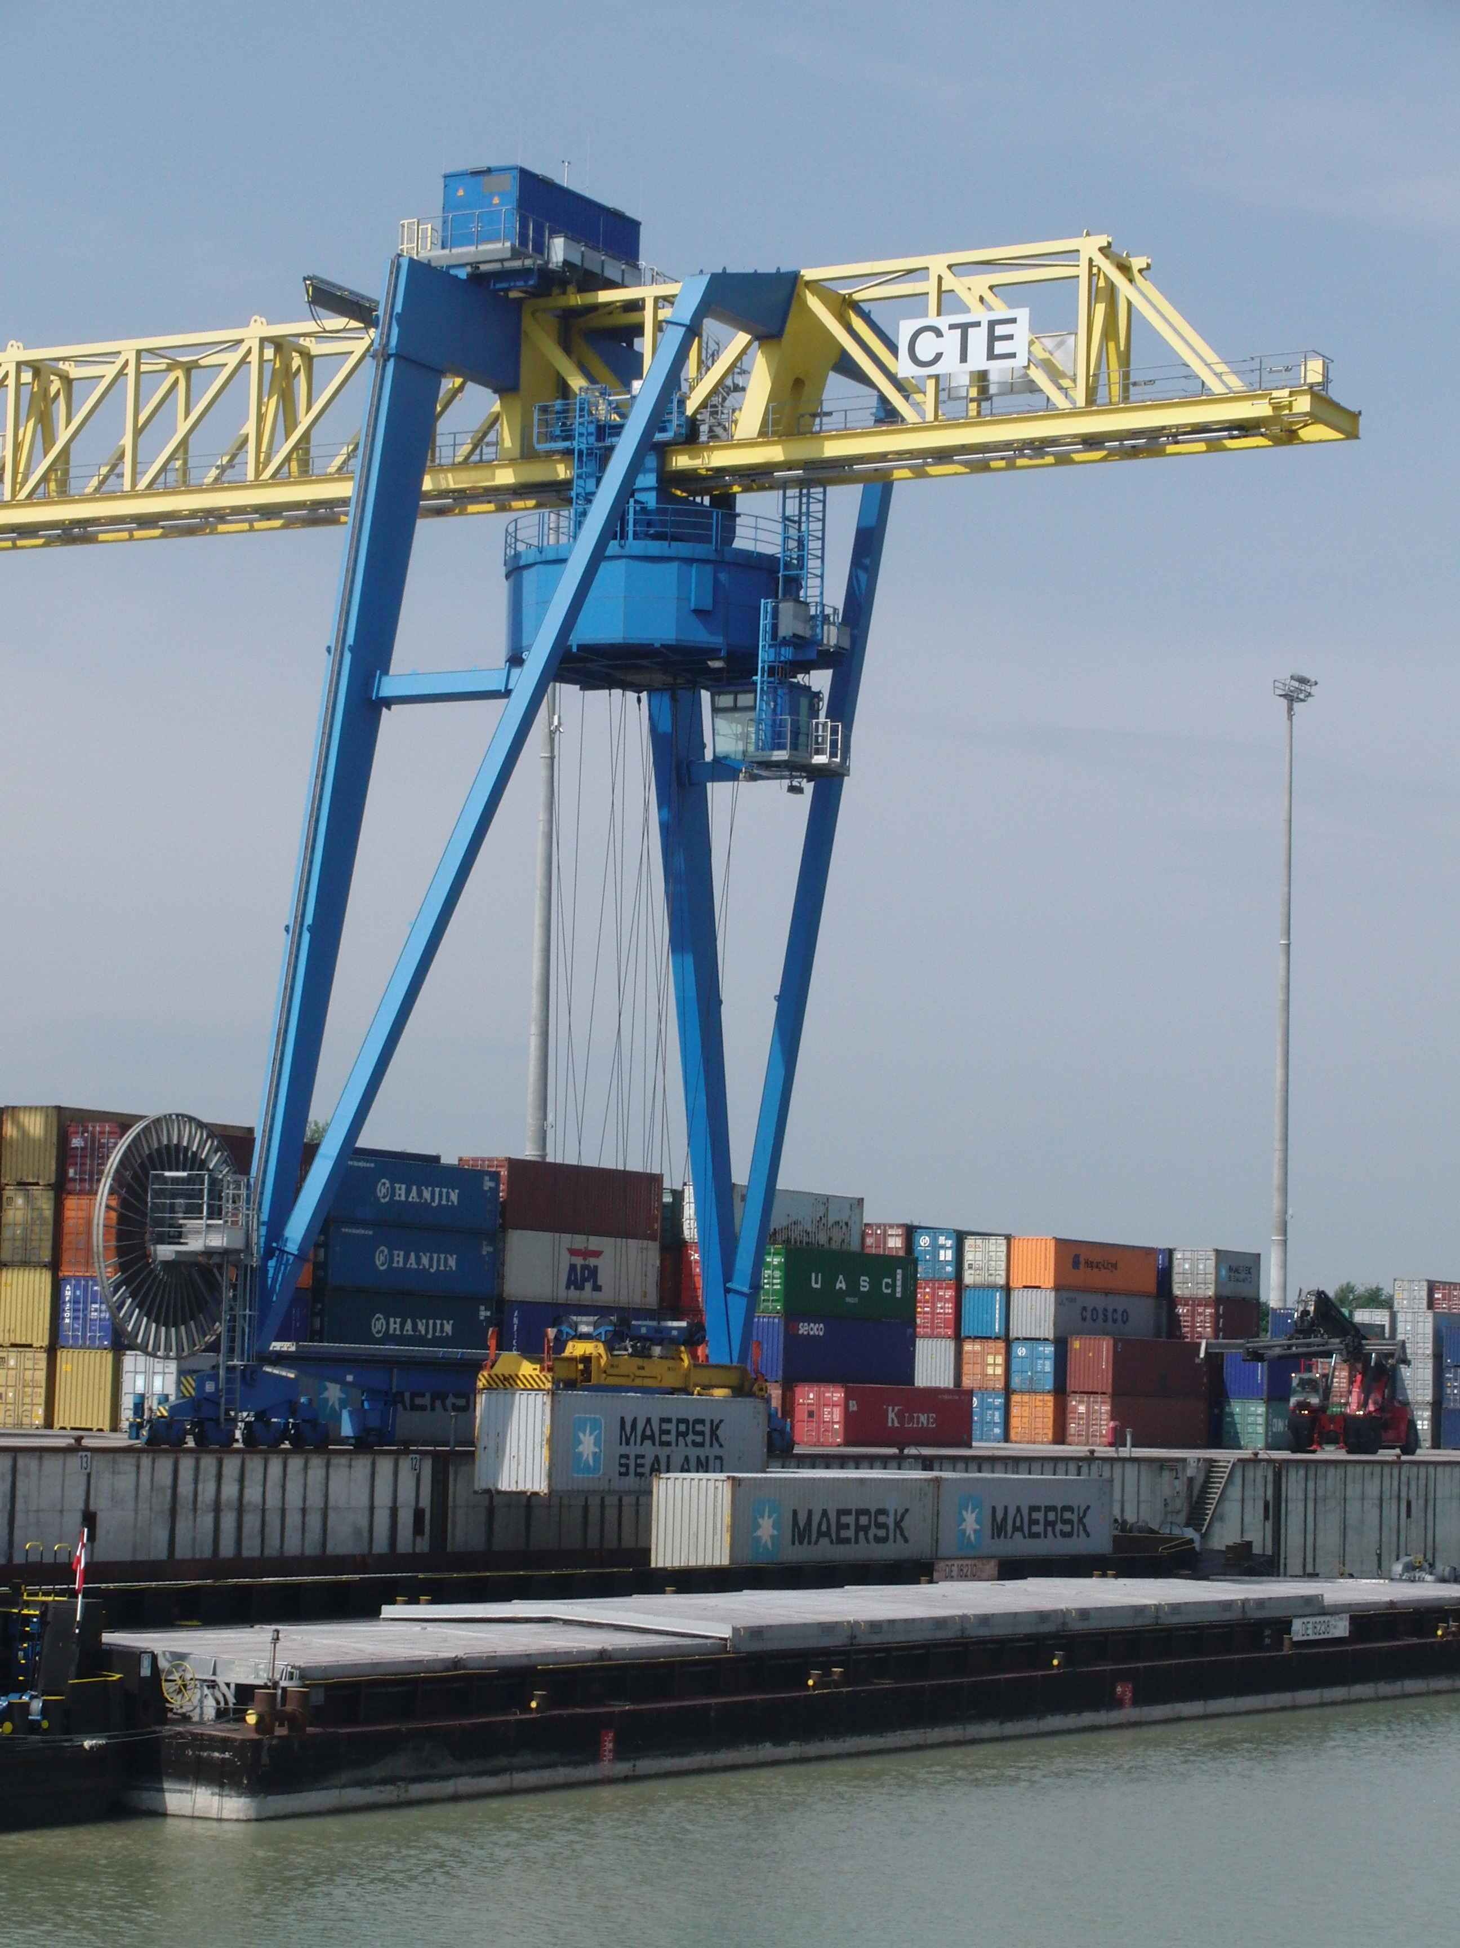
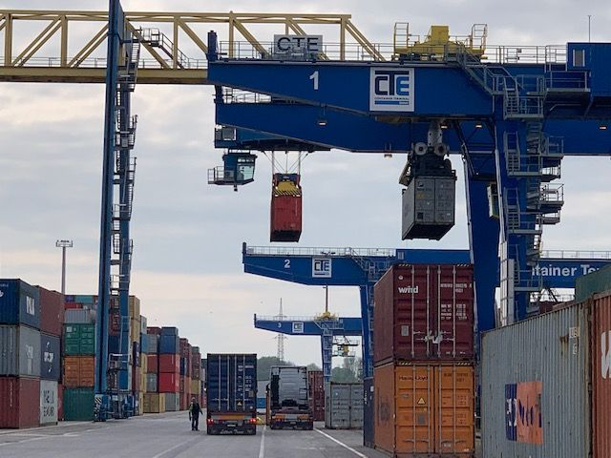
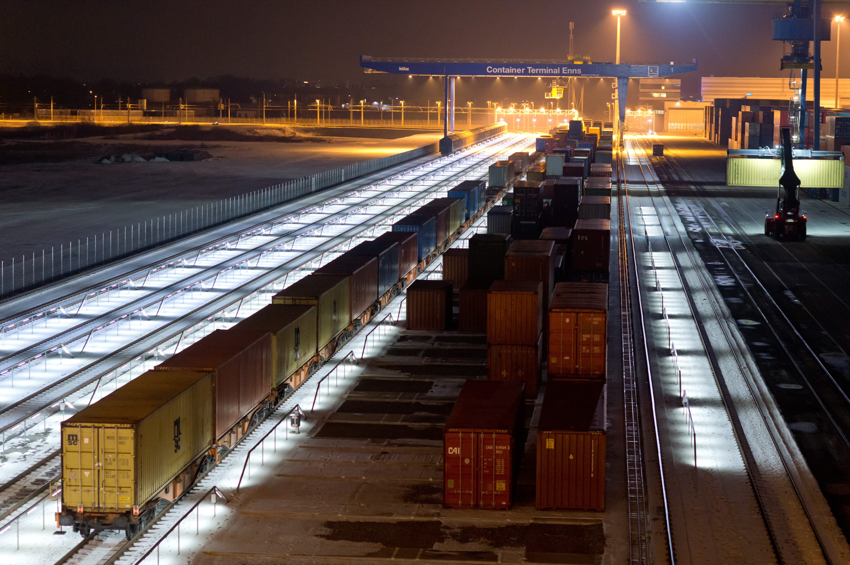
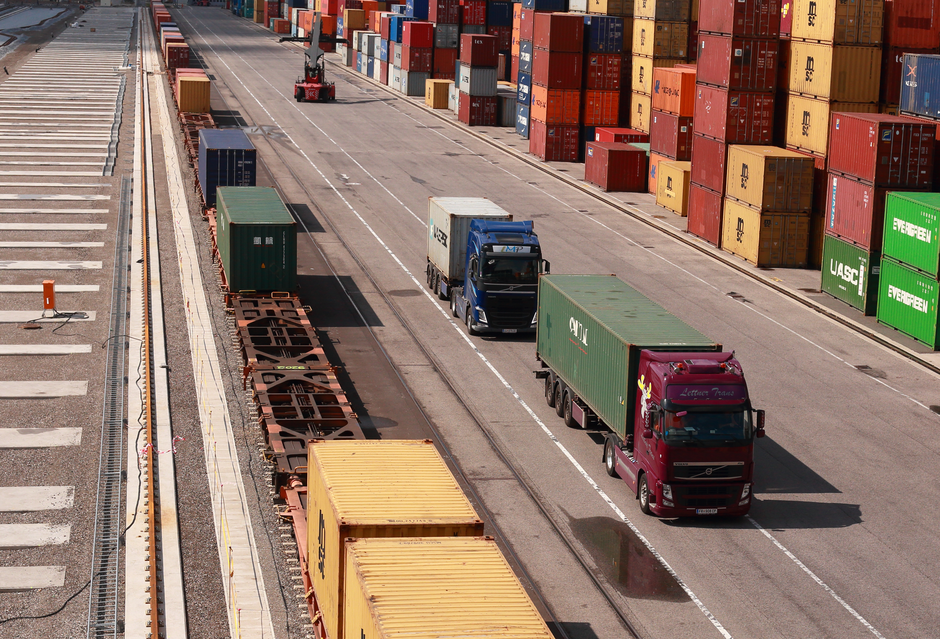
Some practical examples regarding energy items for ports to come to a transformation plan towards sustainability / green energy (4)
Most of your CO₂ will probably come from vessel traffic (from cradle to your port), from railway in/out transport and from trucks
Copyright: Containerterminal Enns
Copyright: Containerterminal Enns
Copyright: ENNSHAFEN
Copyright: Containerterminal Enns

Slide 32
Some practical examples regarding energy items for ports to come to a transformation plan towards sustainability / green energy (5)
You may optimize the energy efficiency of your buildings
(energy class A, A+, A++), but most probably this is only
a small fraction of your total CO₂ balance
Go the way and improve your building, if you have enough
money you can spend on this – but don´t forget the really drivers in your port development plan to come to CO₂-neutrality !

Slide 33
Some practical examples regarding energy items for ports to come to a transformation plan towards sustainability / green energy (6)
Measures like following will be in your action plan for CO₂-neutrality:
  Change diesel-fueled transshipment equipment to electricity driven (gantry cranes)
  Install OPS-infrastructure in your port for vessels during berthing
  Consider the distance which is normally driven by the trucks (inbound/outbound) for port traffic > most probably you will find short and medium distances and you can think about alternatives of electricity-driven trucks in the medium-range, which have to be supported by quick-charger of high-Ampere systems
  Considerable amounts may be gained by installation of photo-voltaic (ports normally have huge squares of building roofs and free areas for implementation)

Slide 34
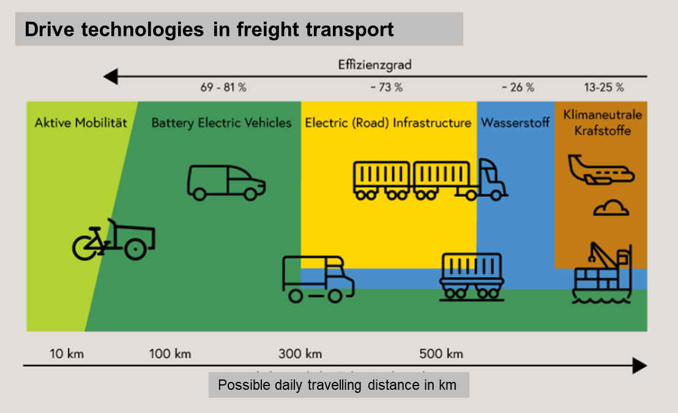
Some practical examples regarding energy items for ports to come to a transformation plan towards sustainability / green energy (7)
But the biggest improvement will be gained when there is an economically viable solution for the big amounts of diesel fuel
Source: BMK

Slide 35
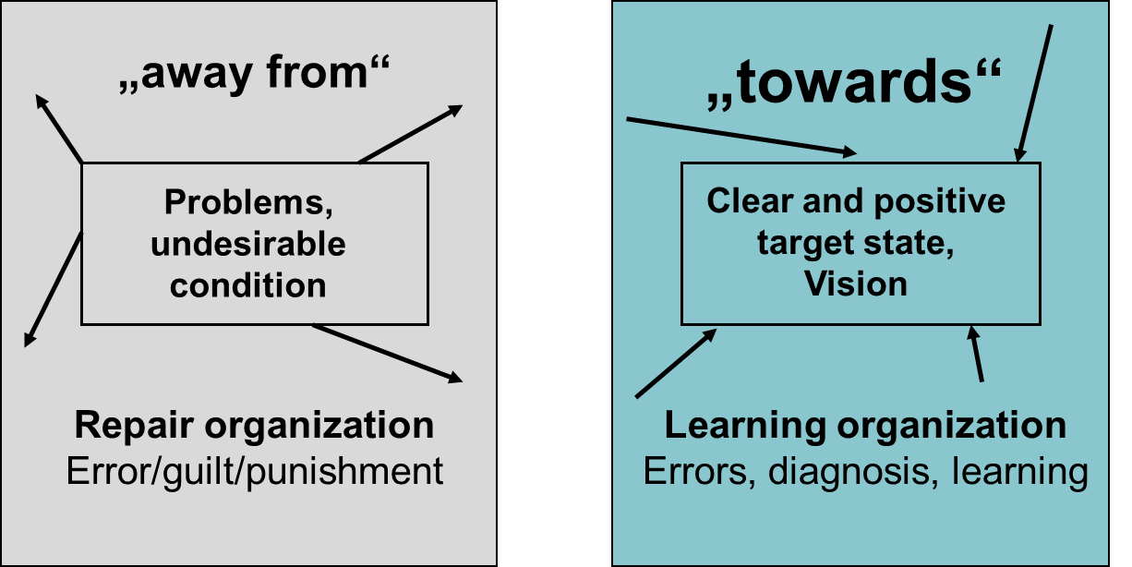
Change processes
Copyright: ENNSHAFEN
Summary: so much has been tried in recent years, so many projects and approaches - no success! We need to focus on one goal, channel all our energy into it and not let it flow away.

Slide 36
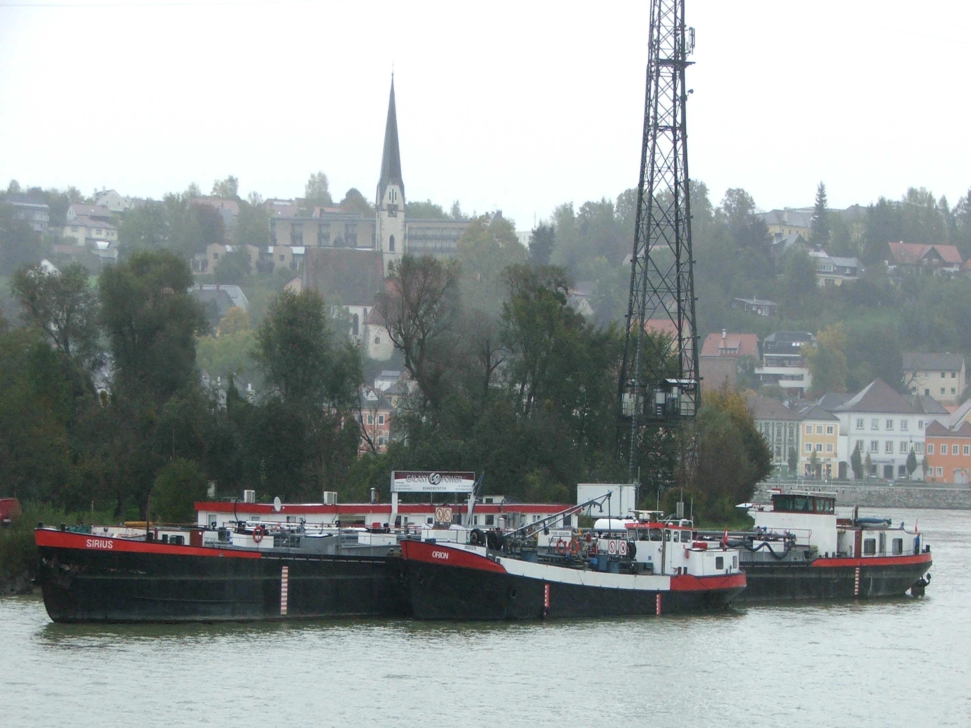
Case study / Industry-Academic Challenge to concentrate on the most promising lever for CO₂-reduction in port business
Inland navigation currently uses diesel as fuel, which leads to significant CO₂, NOx and particulate emissions
Earlier focus on LNG as future fuel was cancelled due to higher CO₂ reduction targets; new targets require a
significantly higher CO₂ reduction by 2050
Studies have not shown an economically
viable solution for significant CO₂ reductions
for inland vessels in short time
Copyright: ENNSHAFEN

Slide 37
Case study / Industry-Academic Challenge to concentrate on the most promising lever for CO₂-reduction in port business
Potential fuels such as HVO100 and e-fuels may be a solution, but require availability and economic viability
The challenge is to quickly develop the European diesel fuel market for shipping in order to have a 20% CO₂ reduction by 2035 > better to reach 20 % via perhaps blending of existing diesel than talk everytime of zero emission but without any idea how to reach this point economically & technically viable

Slide 38
Conclusions and take-home message
Learning objective after completion of the course
Don´t talk about targets and strategies and plannings, plannings, plannings – come into works and just do it
Don’t make a parallel world for energy in your port´s business, make fully integration with complete business, wishful thinking for energy improvement doe´s not improve the climate situation

Slide 39
Conclusions and take-home message
Learning objective after completion of the course
Come to action and do better small steps, but do them and don’t wait – and do these PDCA and improvement each month / year when integrated in your dash-board
Take supports like the SEANERGY Masterplan and use it as a checklist or alignment for your work and start – but start now and not next year !

Slide 40
References
Pictures and Figures, copyright:
“Kirchengast-Steininger-Schleicher, WEGC, 2020 / ENNSHAFEN /
Port of Rotterdam / Containerterminal Enns /
BMK-Federal Ministry of Climate
Links:
CSRD-Standards
https://eur-lex.europa.eu/legal-content/EN/TXT/?uri=CELEX:32022L2464

Slide 41


