Slide 1
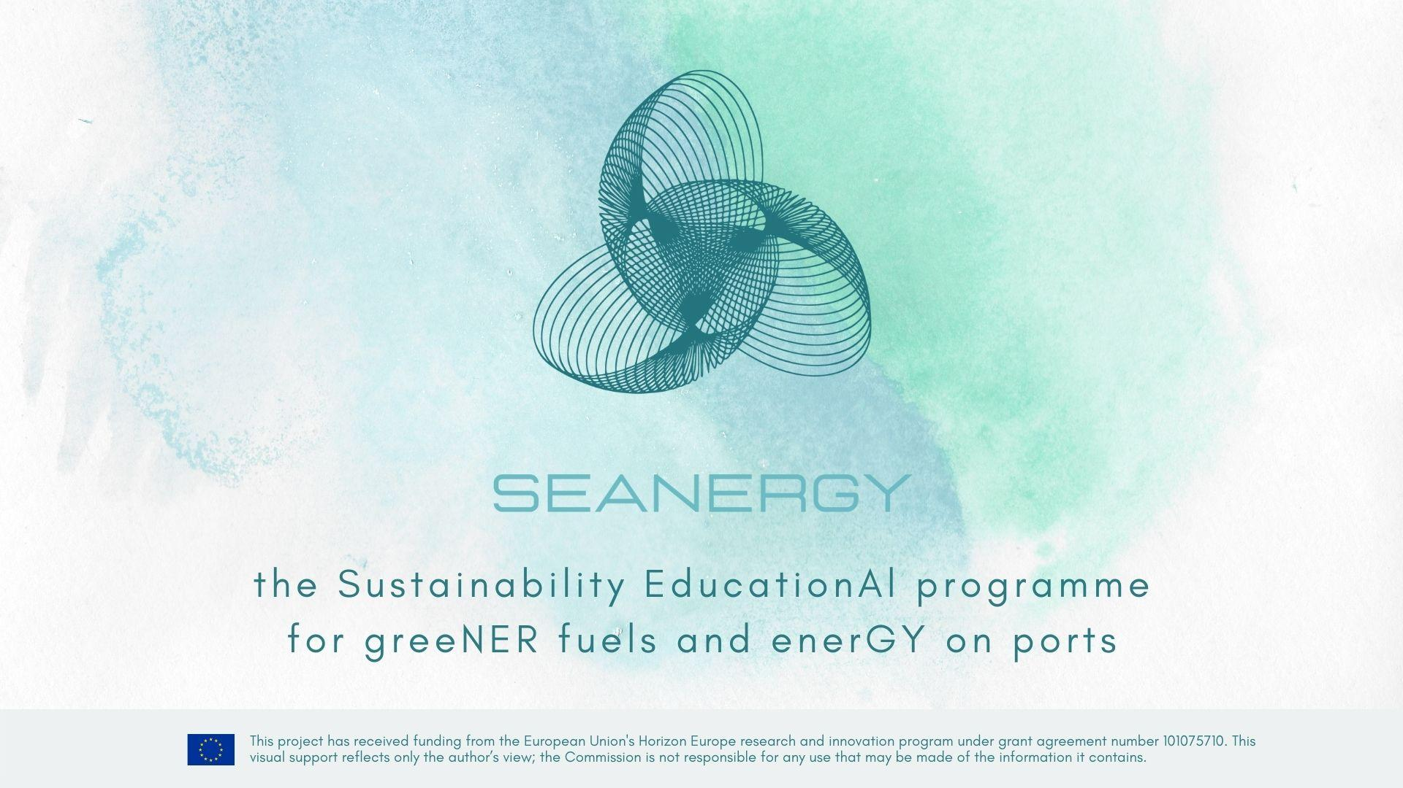




Slide 2

Module 6
Local Master Plan Development
Course coordinator(s):
Werner Auer (main coordinator), w.auer@ennshafen.at
Ronny Lorch, rl@argo-anleg.de
Name of the organization, country:
Ennshafen OÖ GmbH, Austria
Argo-Anleg GmbH, Germany

Slide 3

Learning objectives of the course
On completion of this course, the participants will be able to:
(i) develop a basic knowledge of establishing an inland port development plan with support of the SEANERGY master plan;
(ii) improve your existing knowledge and experience on inland port business regarding energy-related items;
(iii) identify options for fulfilling the future challenges of inland ports regarding energy;
(iv) learn about best practices and strategy developments of inland ports supported by the SEANERGY master plan.

Slide 4
